Slide 1
The Watson College of Engineering and Applied Sciences

Slide 2
Agenda
Different Majors within Watson
Engineering Design Division
Senior Projects
Lab Spaces
Research Opportunities Within Watson
First Year Research Immersion Program
Innovative Technologies Complex
Watson Competes
Watson Career Connections
Prominent Alumni
After Graduation Placements
Continuing Education
Q&A

Slide 3
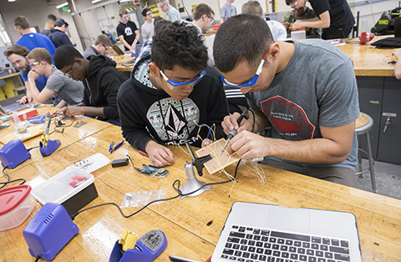
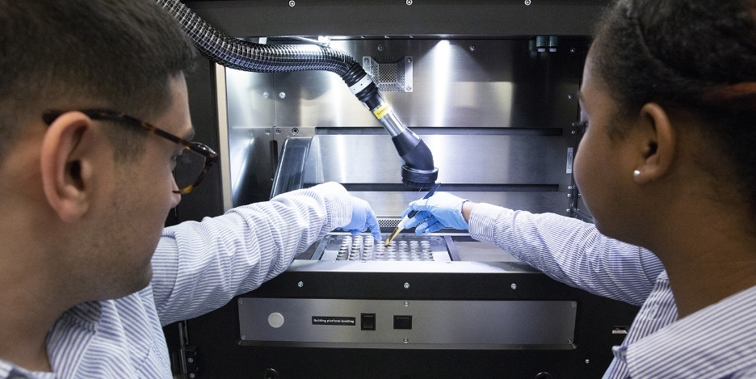
Different Major
Engineering
Biomedical
Mechanical
Industrial & Systems
Computer
Electrical
Sustainability Engineering (Minor)
Computer Science

Slide 4
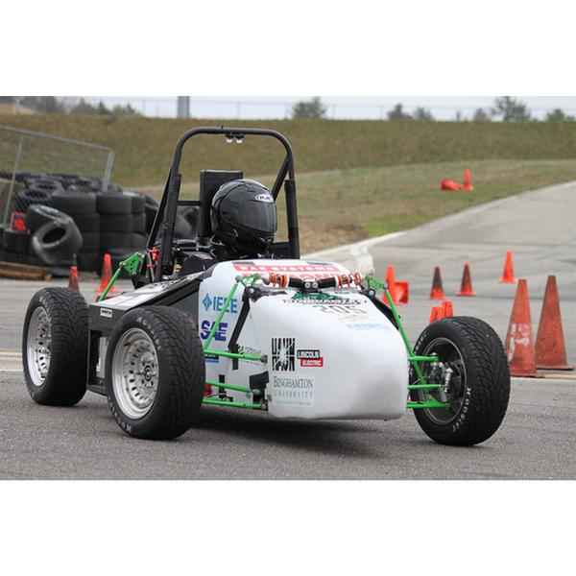
Engineering Design Division
All first year engineering students take the same 4 courses:
EDD 103 – Engineering Communications I
EDD 111 – Intro to Engineering Design
EDD 104 – Engineering Communications II
EDD 112 – Intro to Engineering Analysis
Senior Projects
Examples:
3D Printed Hand
Building a Go-Kart
Building a Dashboard of a Nuclear Facility

Slide 5
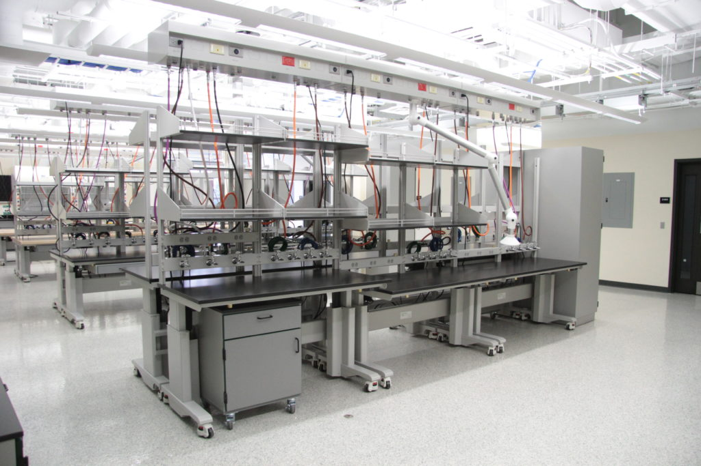
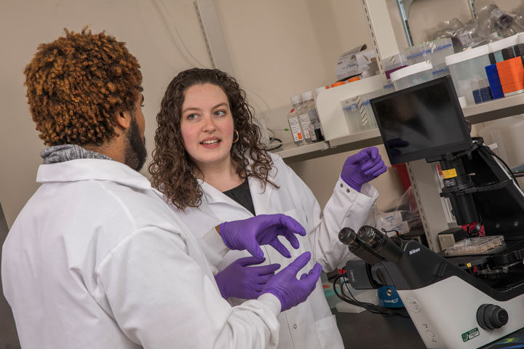
New Engineering Labs
Engineering Lab #1

Slide 6
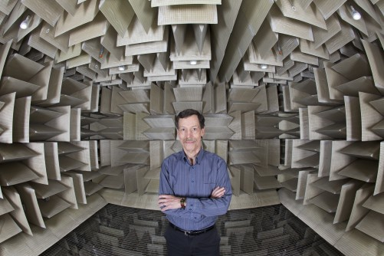
Research Opportunities within Watson
First Year Research Immersion Program
Three semester program where you can start doing research right in your first year
Clean Energy & Image and Acoustic Signals Analysis
Innovative Technologies Complex
Numerous labs for research
Anechoic Chamber
M. Stanley Whittingham Laboratory
ITC Image #1
ITC Image #2
Numerous other research opportunities

Slide 7
Anechoic Chamber

Slide 8
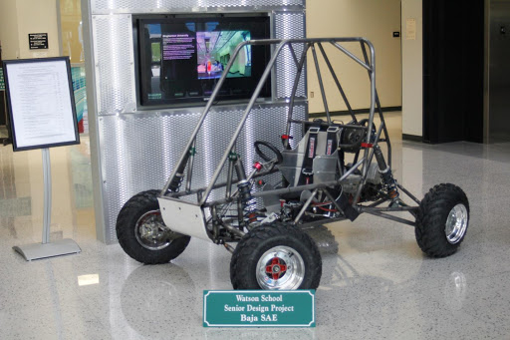
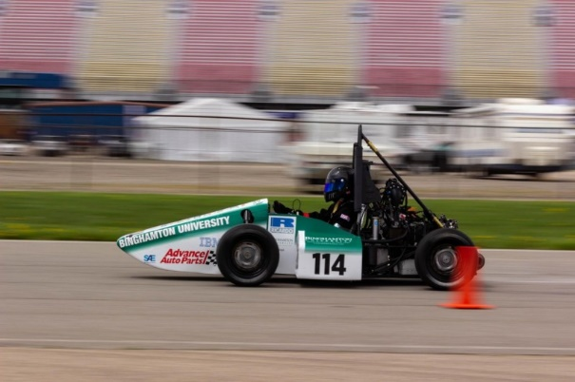
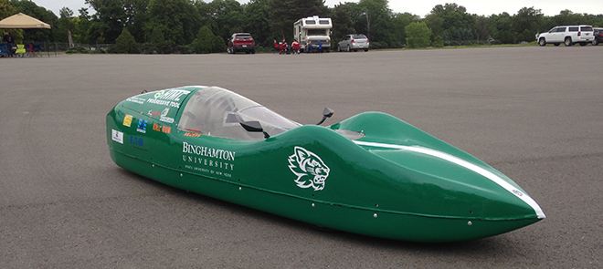
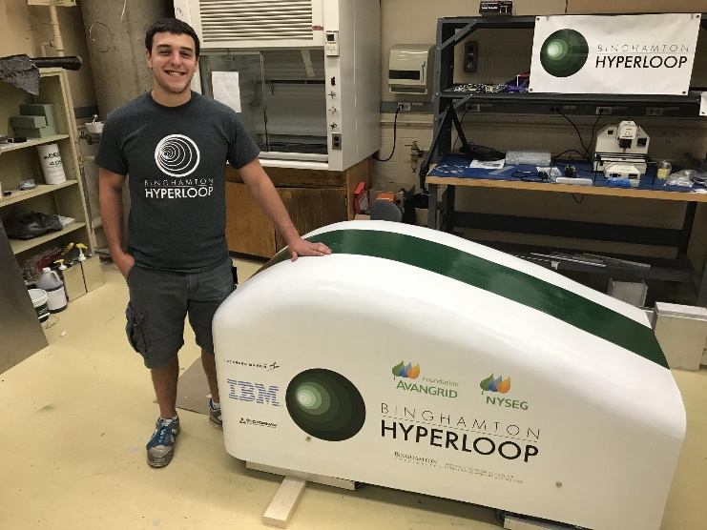
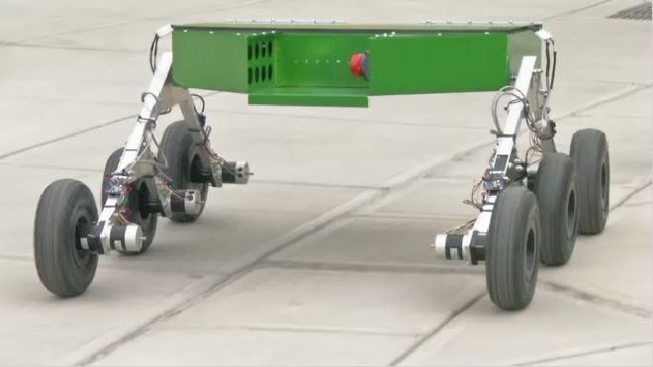
Watson Competes!
Motorsports
Mini-Baja
Formula
Supermilage
Hyperloop
HackBU
Mars Rover Team

Slide 9
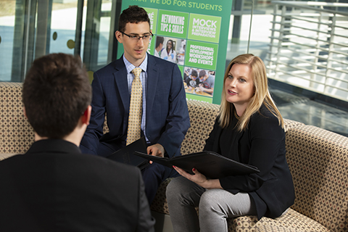
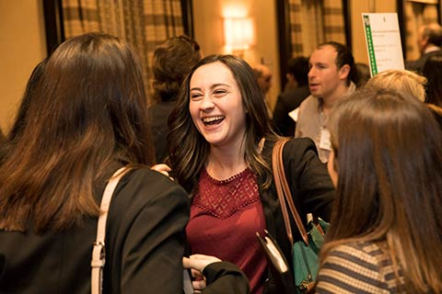
Watson Career Connections
Specific career counselors for all Watson students
Engineering and computer science specific resumes and cover letters
Mock interview sessions
Networking opportunities and trips
Alumni connections
Job and internship search assistance

Slide 10
Notable Companies
BAE Systems
IBM
Lockheed Martin
Google
Amazon
JP Morgan Chase & Co.
Bloomberg
EY (Ernst & Young)
Protiviti
Citi

Slide 11
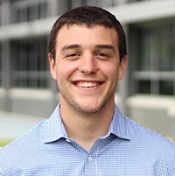
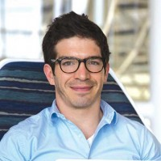
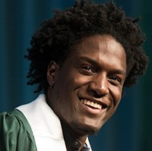
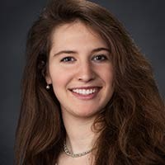
Watson College Alumni
Tyler Mehlman ’16, MS ‘17
Mechanical Engineer, The Boring Company
James Warner ‘08
Computer Scientist, NASA Langley Research Center
Tremayne Stewart ‘16, MS ‘17
Software Engineer, Google
Devan Tracy ‘13
Senior Project Engineer, Lockheed Martin

Slide 12
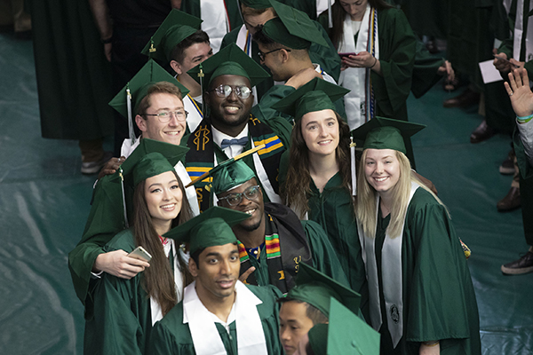
Continuing Education
4+1 Programs
Biomedical Engineering (MS)
Mechanical Engineering (MS)
Industrial and Systems Engineering (MS)
Computer Engineering (MS)
Electrical Engineering (MS)
Business Administration (MBA)
Saves Time
Save Money
Higher Average Starting Salary
Advances Career

Slide 13
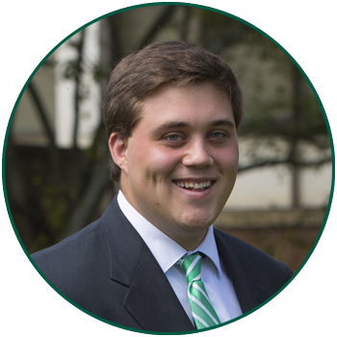
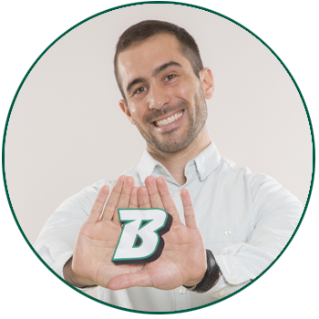
Questions?
Douglas Harrington, Admissions Counselor
dharring@binghamton.edu; 607-777-3169
Craig Broccoli, Associate Director
cbroccol@binghamton.edu

